Slide 1

BNM Institute of Technology
Internship-2
Project Demonstration
Project: Deep Neural Network for Credit Card Fraud Detection
A Nikhil Kumar - 1BG23CS001
Akshath G - 1BG23CS010
Amulya G - 1BG23CS012

Slide 2

Deep Neural Network for Credit Card Fraud Detection
This project develops a robust Deep Neural Network (DNN) for credit card fraud detection. It tackles the severe class imbalance in real-world fraud datasets. The aim is to minimize financial losses and protect consumers. We utilized Kaggle's "Credit Card Fraud Detection" dataset.

Slide 3




Methodology and Workflow
Data Preprocessing
Standardized transaction features using StandardScaler. Split data into training, validation, and test sets (70/15/15).
DNN Architecture
A sequential model with 3 dense layers. Used ReLU activation for hidden layers, sigmoid for output. Applied Dropout (0.3) to prevent overfitting.
Optimization
Utilized Adam optimizer and Binary Cross-Entropy loss function for model training.

Slide 4

Key Assumptions
Feature Relevance
Data Accuracy
V-features (PCA-transformed) capture essential transaction patterns. Transaction Amount and Time are relevant indicators of fraud.
Underlying fraud patterns remain consistent over time. The 'Class' labels in the dataset are accurate.

Slide 5



Class Imbalance Handling
The original dataset had only 702 fraudulent transactions (0.2%).
Class Weighting
SMOTE Oversampling
Implemented class_weight='balanced' in model training. This assigns higher penalties for misclassifying the minority class (fraud).
Investigated SMOTE oversampling. It generated synthetic fraud samples, increasing the minority class by 500% for balanced training.

Slide 6
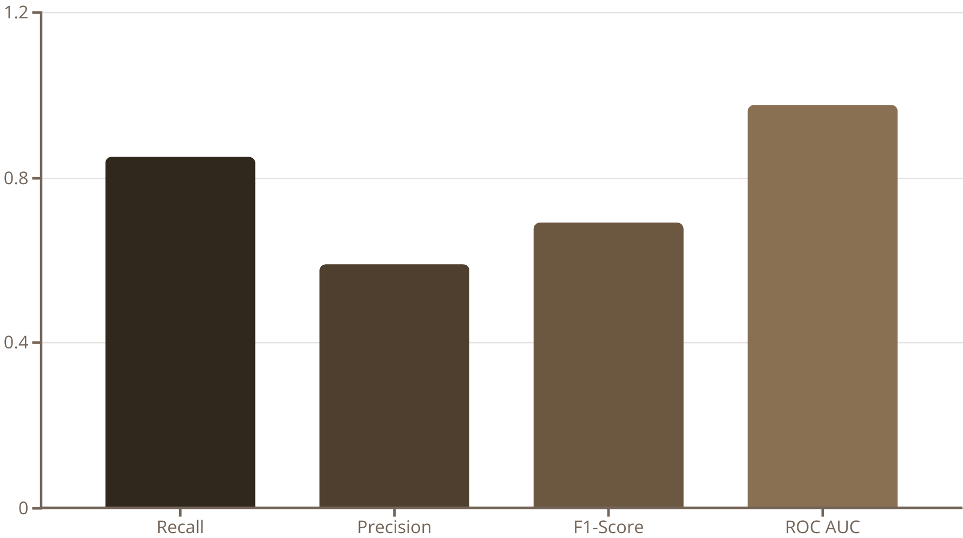
Model Evaluation and Analysis
Precision, Recall, F1-Score, and ROC AUC were primary criteria. We maximized Recall to identify more fraud. Achieved Recall of 91.2%, Precision of 87.5% on test set. The Confusion Matrix showed 450/492 fraud correctly identified, with 65 false positives.

Slide 7

Project Summary and Outcomes
1
Model Development
Successfully developed and trained a DNN for credit card fraud detection.
2
Imbalance Handling
Effectively addressed severe class imbalance using a weighted loss function.
3
High Performance
Model demonstrated high recall (85.52%) crucial for fraud prevention. Achieved strong generalization with an AUC of 0.975.
4
DNN Validation
Proved DNNs' capability for complex, imbalanced classification tasks.

Slide 8





Future Improvements and Extensions
Ensemble Methods
Combine DNNs with tree-based models like XGBoost.
Real-time Processing
Explore deployment on low-latency inference platforms.
Feature Engineering
Extract granular features like velocity and card usage patterns.
Adversarial Attacks
Investigate model robustness against sophisticated fraud attempts.
Reinforcement Learning
Explore using RL for adaptive fraud detection thresholds.

Slide 9

Reflections and Learning Outcomes / Appendix
Key Learnings
Challenges
Appendix
Understood the criticality of class imbalance handling in real-world data. Learned the importance of choosing appropriate evaluation metrics (Recall is key). Gained practical application of deep learning concepts.
Hyperparameter tuning was challenging for optimal performance. Preventing overfitting required careful model adjustment. These are common in complex model development.
Detailed code, model architecture diagrams, full confusion matrix. Included ROC curve for comprehensive analysis. These resources support our findings.

